Slide 1
APPLE COMPANY
Institutional Affiliation professor's Name
Date

Slide 2
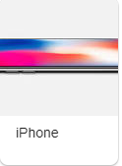

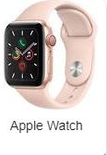
INTRODUCTION
Apple Inc. is an international tech company which is located in America. Its head office are in Cupertino in California
Apple Company is among the largest tech companies that designs, develops, and vends computer software, consumer electronics such as mobile phones as well as offering online services
Some of its hardware merchandises include the iPad tablet computers, the iPhone smartphone, the Home Pod smart speaker, etc.
Apple's software comprises of the Shazam music identifier, iPods, tvOS, macOS and watchOS operating systems, the iTunes media player, and the Safari web browser
Apple offers online services such as the Ios App store, Apple TV+, Apple Music, Apple Pay Cash, Genius Bar, Apple card, iCloud, among other services
So I work as an IT manager in the apple company, and I made this observation on Friday, 7/11/2020, in the afternoon
Apple products.

Slide 3
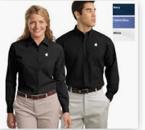
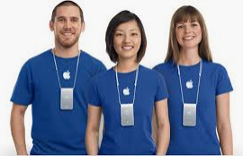

PROFESSIONAL APPEARANCE EXPECTATIONS
Proper dressing in the workplace not only increases an employee's confidence but also attracts and impresses other people they work with.
The way employees dress reflects how they view their work and the way other people see them and the company
The following are ways through which employees are supposed to dress in the apple company to maintain a professional image at work.
The employees' shoes and clothes should always be fresh and clean.
Clothes should be ironed to prevent wrinkles, and missing buttons should be replaced immediately.
Nails should always be clean and trimmed. Nails are indicators that someone pays keen attention to details at work.
Employees should not put on clothes that are so short, tight, revealing, or baggy.

Slide 4

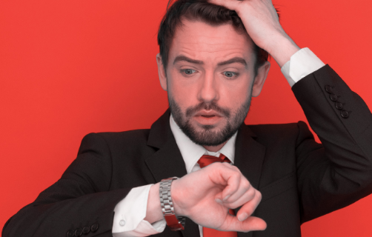
PROFESSIONAL BEHAVIOR EXPECTATIONS
Communication is essential in for a good relationship in the workplace place.
Employees and managers should respectfully address each other.
For instance, if an employee is not okay with his/ her colleagues' dress code, it is kinder to tell him or her that "your clothes are too tight or revealing" rather than telling them, "you look so messy.“
New employees who face problems in the workplace should seek help from their supervisors or either their colleagues who have been working for the company before them.
If there is a valid reason to be late, an employee should talk to his/her supervisor to compensate for the time he/she lost.
In Apple Company, employees asre expected to be at the workplace by on time.
During working hours, employees are advised to keep away their mobile phones to avoid disruption.

Slide 5
PROFESSIONAL FIT
Am I able to stand firm to debate and defend my point of view about an inevitable discussion? This question is important because Apple Company wants employees who confident about themselves and their opinions to make things enhanced or better.
Am I able to abide by the Apple Company's rule against viewing customers' photos? This is because the company values its customer's privacy.
Am I able to work for approximately 8 to 10 hours per day in five days? This is because employees in the apple company work from Monday to Friday, which totals to about 50 hours per week.
Am I able to keep the company's secrets? This is because Apple Company values secrecy, and revealing secrets about the company can make an employee lose their job.

Slide 6
Reference
DANS, E. (2020). Apple Health.
Lashinsky, A. (2012). Inside Apple: How America's most admired--and secretive--company really works. Hachette UK.
Vozza, S. (2017). Why employees at Apple and Google are more productive. Fast Company.

